Slide 1
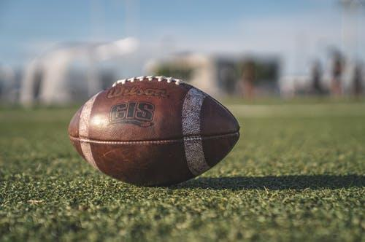
Predicting Wide Receivers Performance in the NFL
A Data Science Capstone Project
Adrien Saremi

Slide 2
Background and Motivations
What is the NFL Draft?
A yearly event, where each team recruits among recent college athletes who declared to play professional.
The General Manager (GM) has a pool of players to choose in order to satisfy the team’s needs.
The Wide Receiver (WR) role is among the most important positions in football and GM’s always allocate resources in recruiting receivers

Slide 3
Background and Motivations
Q: Do performances as a college athlete carry over in the professional league?
Q: Does the NFL combine really have an impact on a WR’s recruitment?
A: It’s not as easy as pie! Many factors come into play: player’s conference of origin, class status upon entry of draft, number of games played at college level...
Recruiters need extensive data in order to recruit WR’s during the NFL draft

Slide 4
Our objective
GM’s are interested in recruits’ performance during first contract (≈ 5 years)
-> How many yards will a drafted WR catch during its first 5 years?
Our steps:
Capture reliable data
Find correlation and run statistical tests between collegiate performances and our target
Build a Machine Learning based model to predict our target

Slide 5
Data Wrangling
Use BeautifulSoup to scrape pro-football-reference and sports-reference
Collect the NFL and CFB data for WR’s drafted between 2000 and 2011
Download the combine file from Kaggle and save the data of WR only
Merge the two by draft’s year and pick or by name.
Clean the data.

Slide 6
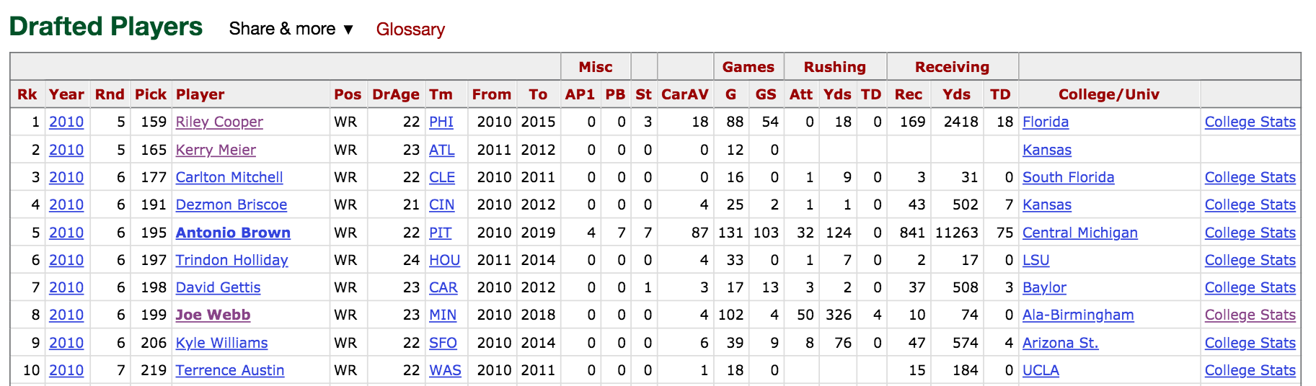
BeautifoulSoup and sports-reference
a) Scrape Table
c) Capture CFB url
b) Capture NFL url
Exceptions: fill in empty entries with np.nan

Slide 7
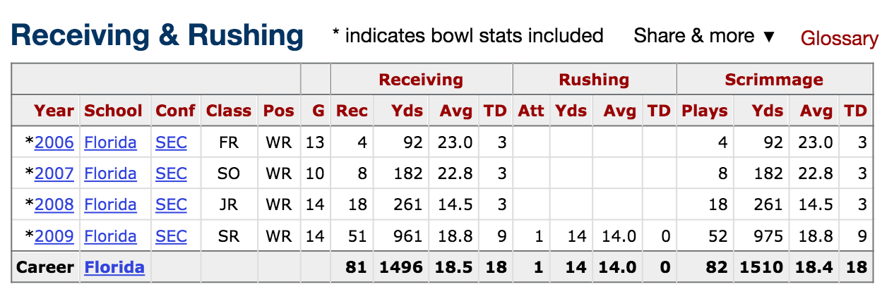
2) CFB page
a) Scrape Table
Issues:
Receiving and Rushing stats are switched
There are multiple schools
b) Capture overall row

Slide 8
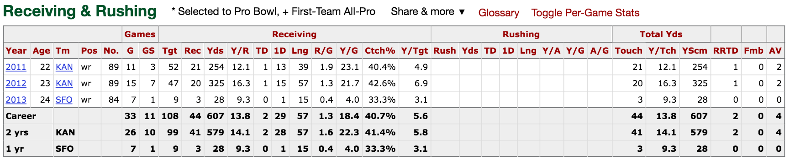
3) NFL page
a) Scrape Table
Issues:
Receiving and Rushing stats are switched
There are multiple teams
b) Capture overall row

Slide 9
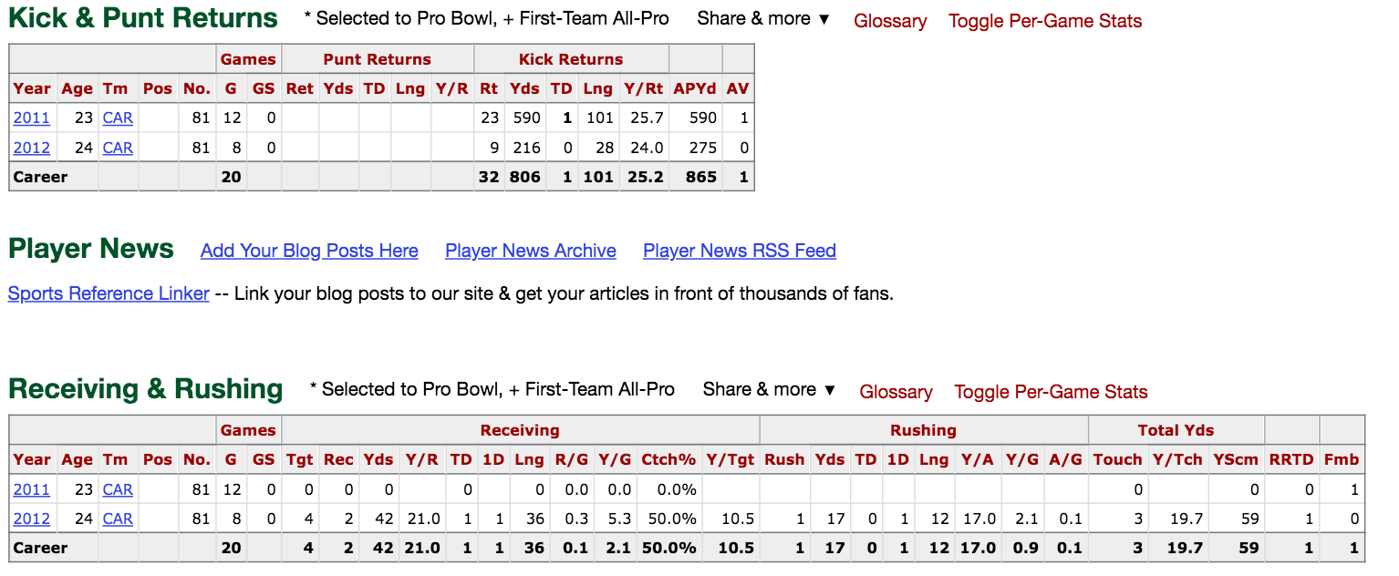
Other Issues - Table is hidden in the page
Use the webdriver.Chrome package!

Slide 10
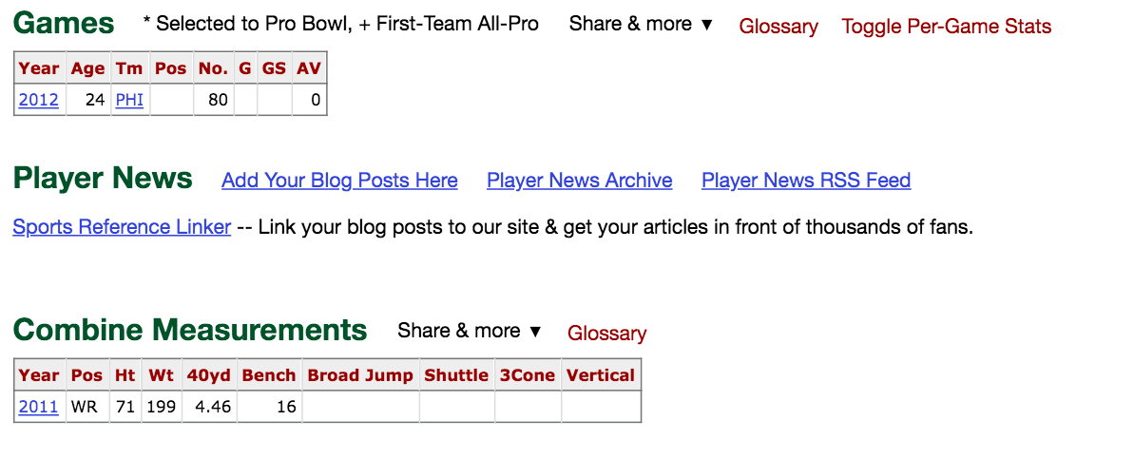
Other Issues - There’s no ‘Receiving and Rushing’ table due to lack of games

Slide 11
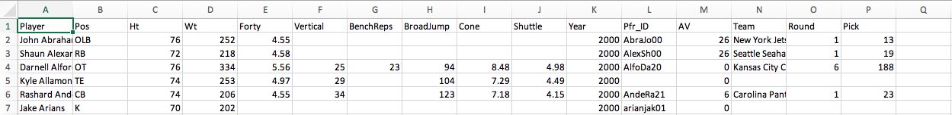
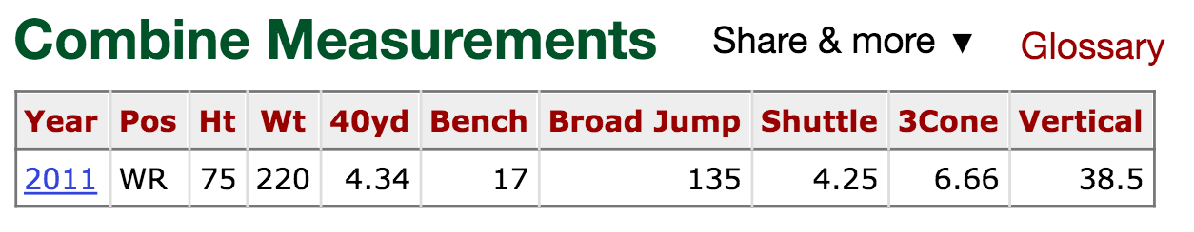
4) The combine table
Download the combine table from the Kaggle website
Search on Pro-football-reference the combine data of each player
Requires:
webdrive.Chrome
data formatting

Slide 12
4 - 5) Merging and Cleaning
Merging by year and name or by year and draft’s position.
Re-organizing the csv file (renaming columns, changing order of columns)
Replacing error messages with np.nan entries for missing data
Replacing with the value ‘0’ (eg player with no rushing stats)
Catch leftover errors via automated functions or manually
Carefully convert all numerical values to floats

Slide 13
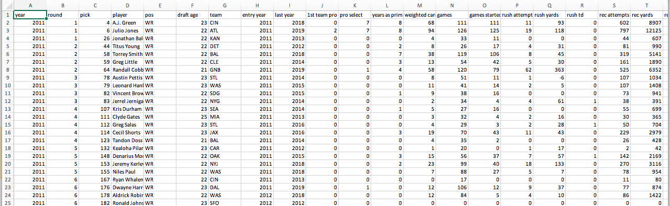
Result
393 data points
300 with complete CFB, combine data
71 with either cfb or combine data only
35 NFL stats to choose our target from
24 cfb/combine input variables

Slide 14
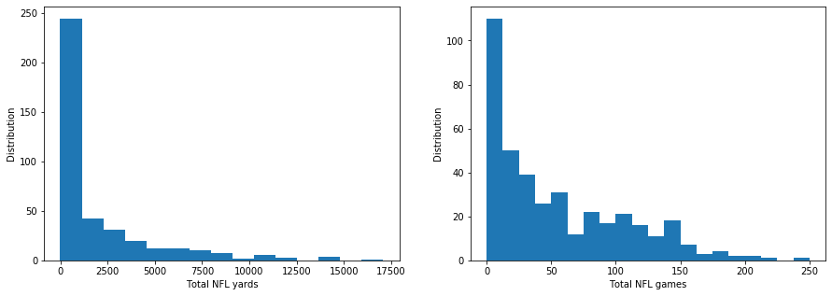
Data Story - Exploratory phase
Q: What variables should we focus our analysis on?
A: Let’s start with evident data
Turns out a lot of players are little to not used at all!

Slide 15
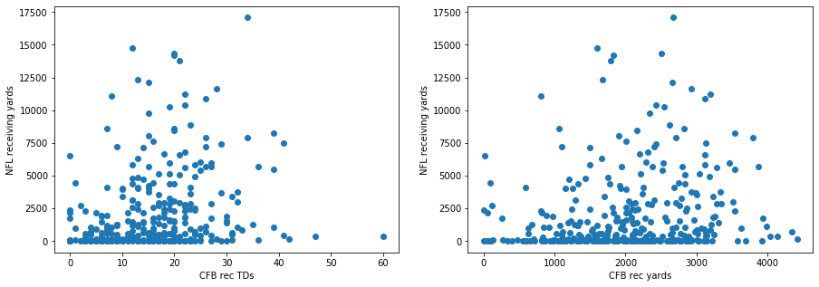
Data Story - Exploratory phase
Q: Is there correlation between cfb and nfl data?
A: Seems to be. Data is hard to interpret

Slide 16
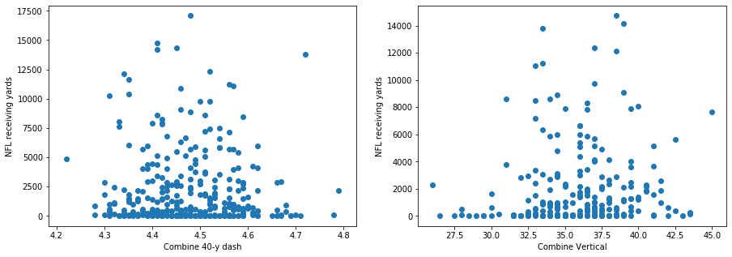
Data Story - Exploratory phase
Q: Is there correlation between combine and nfl data?
A: Seems to be. Data is hard to interpret

Slide 17
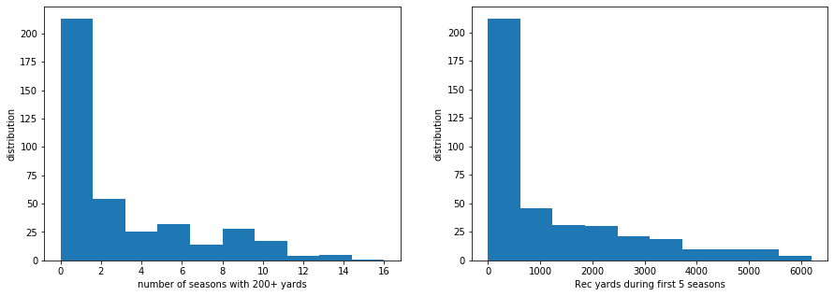
Generating more useful data to GM’s
The number of seasons with yards above a threshold
The number of receiving yards during the first 5 season

Slide 18
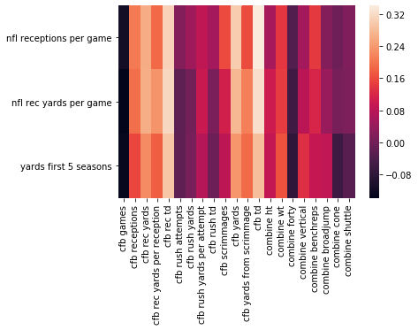
Correlation Matrix
Derive the correlation factor between:
37 possible targets and
22 input numerical variables
Pick 3 metrics with highest aggregate correlation factor
nfl receptions / game
nfl rec yards / game
yards during first 5 seasons

Slide 19
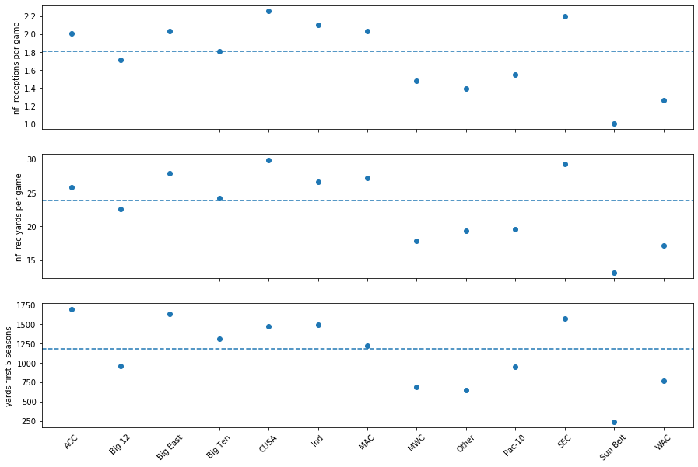
Non numerical Data (e.g. CFB conference)

Slide 20
Statistical Analysis - Inferential Tests
(the choice of an overall aggregate nfl career metric instead would disadvantage players recently drafted)
Our target: y=’yards first 5 seasons’
SEC vs Big12 - Bootstrap Inference
p = 00213
Null hypothesis: the sec and big12 samples are from the same distribution with respect to the mean of y
For all tests, confidence level:
𝛂 = 95%
cfb rush attempts - Scipy Test
p = 0.3569
group1, group2: subgroups of players with cfb rush attempts below, above median.
We test for the independence of the two samples with respect to the target y
cfb receiving touchdowns - Scipy Test
p = 6.0 x 10⁻⁸
group1, group2: subgroups of players with cfb receiving td below, above median.
We test for the independence of the two samples with respect to the target y

Slide 21
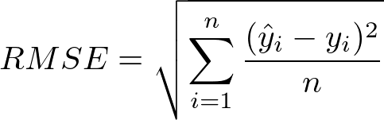
In Depth Analysis (1) - Goal
Using feature variables X, build a predictive model for the target y
Model: Linear regression (Scikit-Learn)
Methods: apply transformation to the data, try different algorithms
Metric for performance evaluation: minimize root mean square error
Split data between train and test or,
Perform cross validation test

Slide 22
Data Transformation
Range for y: 1 < y < 6201
Consider all data point: RMSE = 1515.6908
... receiving td,
... td,
… yards,
… rec yds,
… yds from scrimmage,
… games
Reducing the features X to 6 variables: RMSE = 1437.94
X’ = college ...
Remove outliers: RMSE = 1363.66
Include non numerical features:
get_dummies (pandas)
no effect on RMSE
Applying an Imputer for missing data:
RMSE = 1383.19
SimpleImputer
strategy: mean

Slide 23
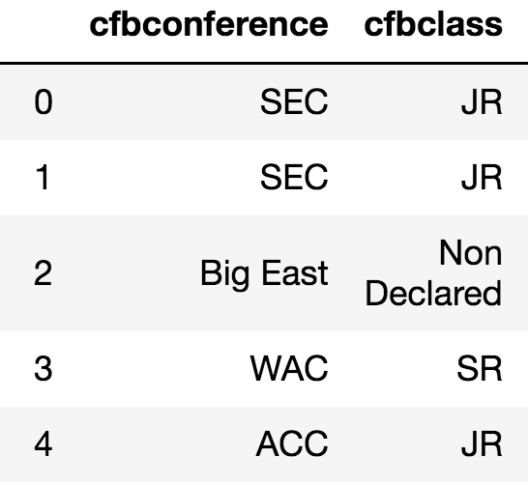
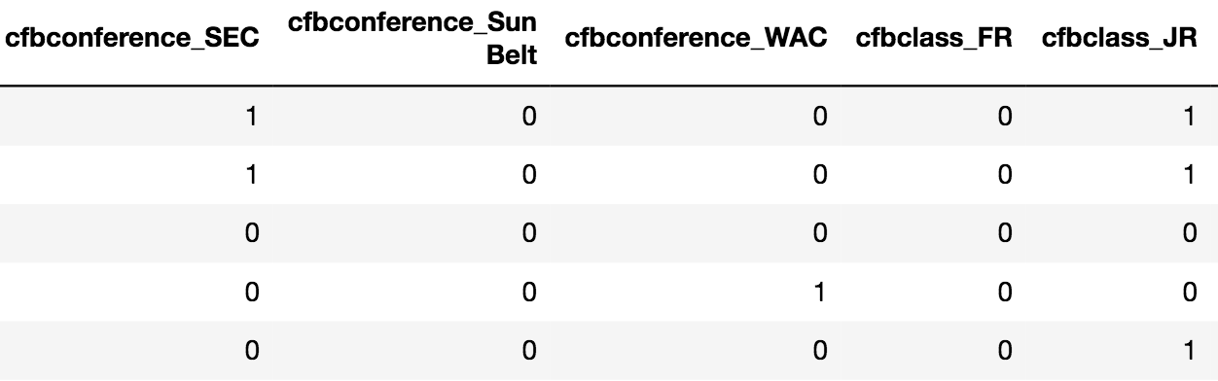
Data Transformation - get_dummies

Slide 24
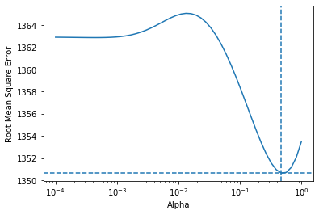
Algorithm - Ridge Regressor
Feature variables X’ (those that correlate the most)
SimpleImputer for missing data
Normalize numerical data
Numericize non-numerical data
Hyperparameter tuning Ridge Regressor using GridSearch CV
Result:
RMSE = 1350.65
𝛂 = 0.686

Slide 25
Conclusion for 1st model
Target y = yards first 5 seasons
Unsatisfactory results: the RMSE is still too high. Still, lessons to be drawn for a GM
High correlation between target and cfb td’s, cfb rec yards
Negative correlation between target and cfb games: player drafted as a junior tends to perform better than a senior
Lack of correlation between target and most of combine features: decision making should rely more on college performances rather than combine stats
Importance of cfb conference: among the power 5 conferences, ACC and SEC players perform better on average. Big 12 players perform worse

Slide 26
In-Depth Analysis (2) - Goal
Target y = yards first 5 seasons
Target: y ≤ 100 ↠ y_{new} = 0 (flop)
y > 100 ↠ y_{new} = 1 (success)
Classification Problem: perform analysis to predict if player is either a flop or a success (binary value based target)
Define new target y_{new} with respect to a fixed threshold
y ≤ 100 ↠ y_{new} = 0 (flop)
y > 100 ↠ y_{new} = 1 (success)
Model: LogisticRegression (Scikit-Learn)
Metric: accuracy of cross validation score - CV_score = 0.66

Slide 27
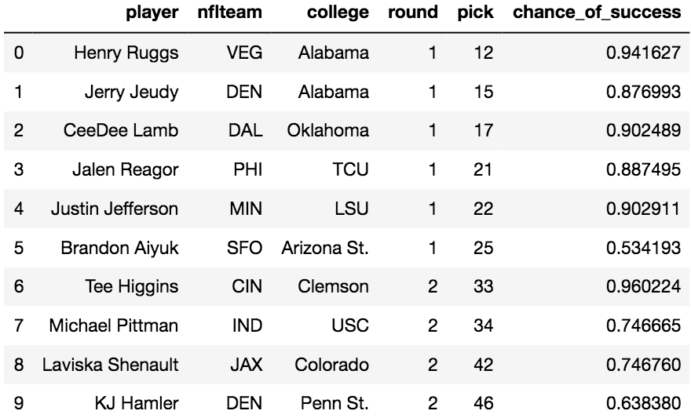
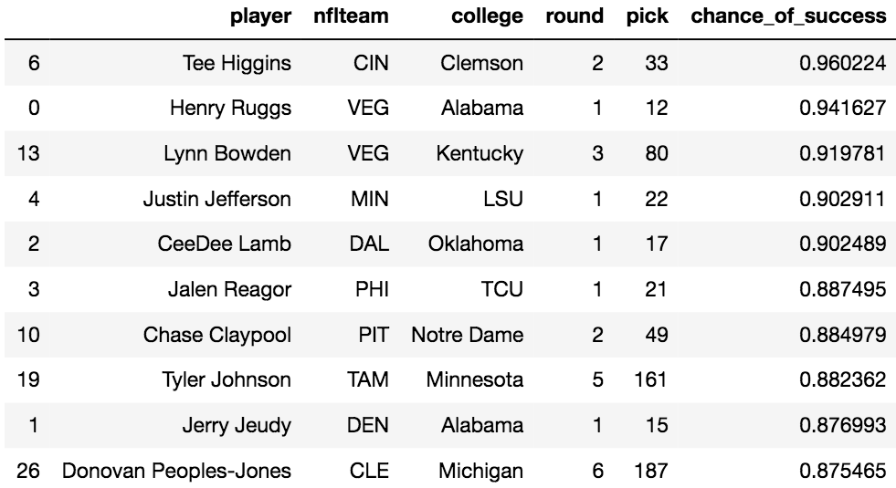
Testing against Class of 2020
P = probability of success
Derive the probability of success of each draftees of 2020
using the predict_proba function of LogisticRegressor

Slide 28
Conclusion for 2nd model
P = probability of success
Valuable information for a GM when drafting WR’s in the league:
Can help confirm the choice of a draftee.
e.g. 2020 draft: model predicts high values of P for top drafted players
P can be used to establish ranking of players prior to the draft:
Potentially shuffles the order of draftees
Players with little spotlight on and yet high chance of success could be drafted in earlier rounds

Slide 29
Predicting Wide Receivers Performance in the NFL
Thank you!

